Slide 1
Before the makeover

Slide 2
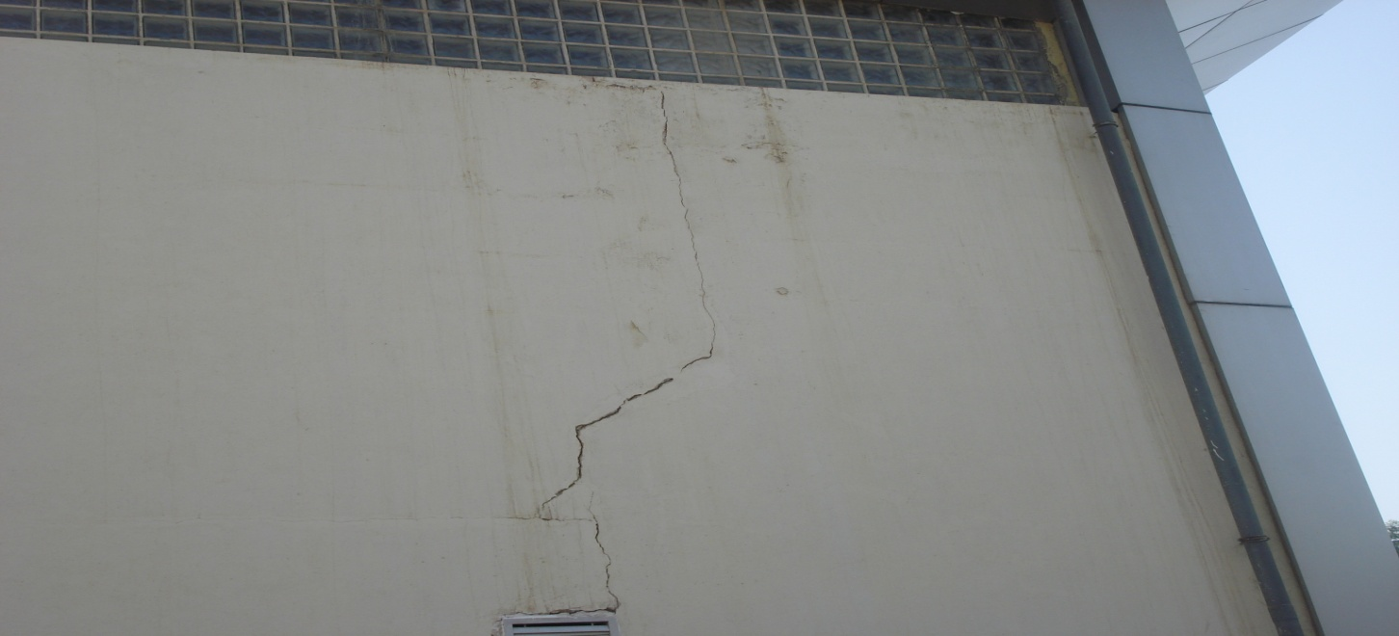
Cracks
In our school the sports hall wall has a very large crack coming from the vent, many people who pass the sports hall may get a wrong impression.

Slide 3
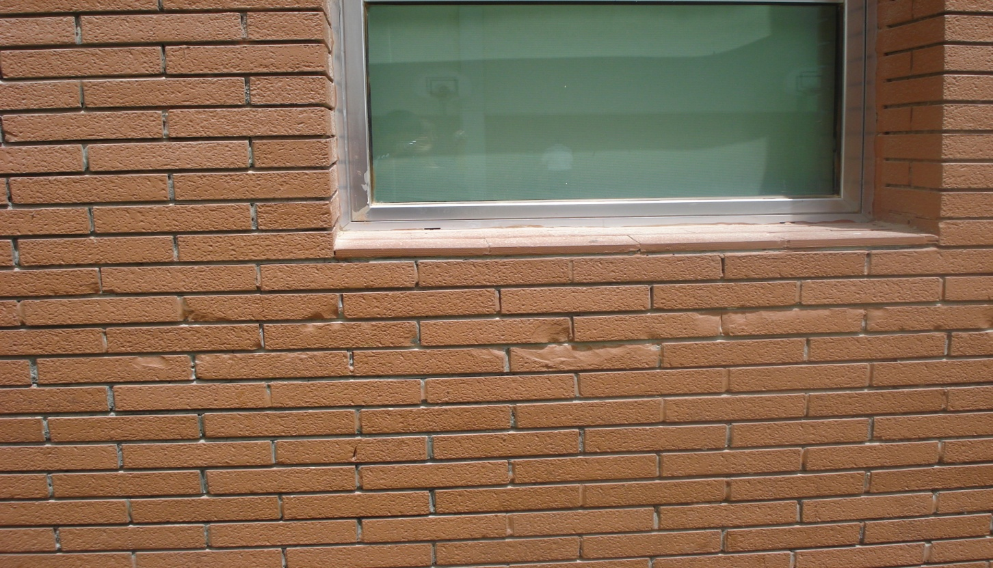
Cement Decay
The wall under a year 3 class room has cement decay, it gives the school bad impression

Slide 4
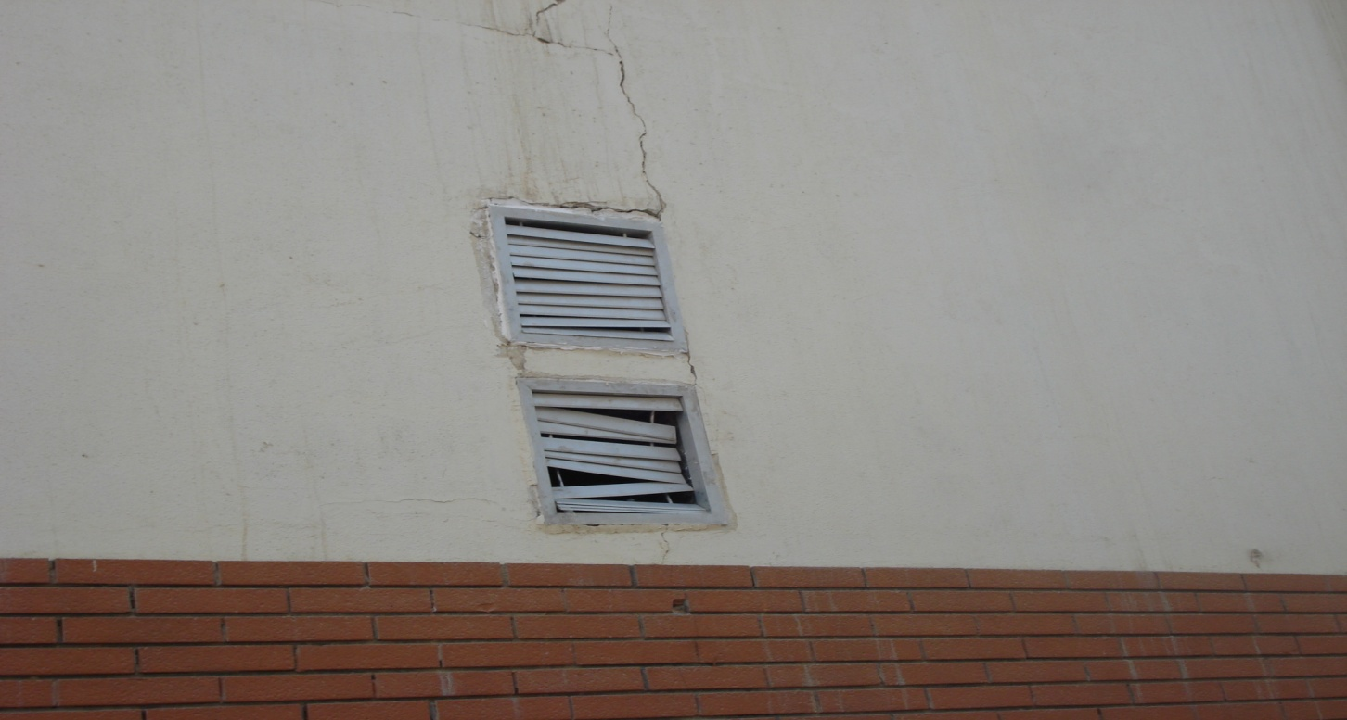
Broken vents
This shows there is poor maintenance

Slide 5
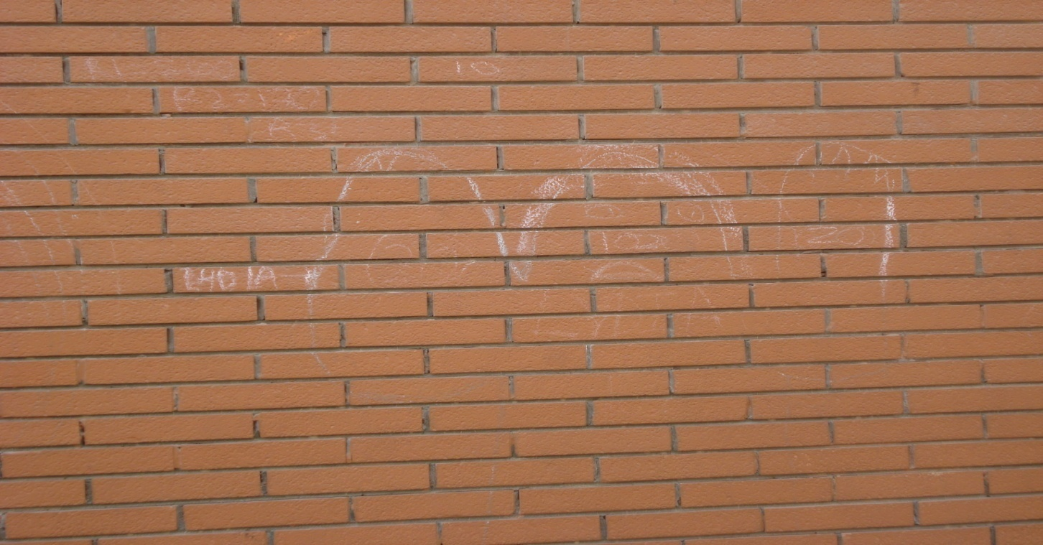
Graffiti
This shows Vandalism

Slide 6
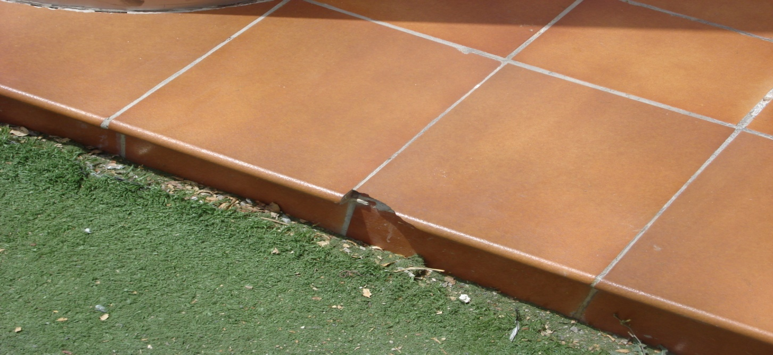
Broken tiles
The broken tiles show neglect and wear and tear.

Slide 7
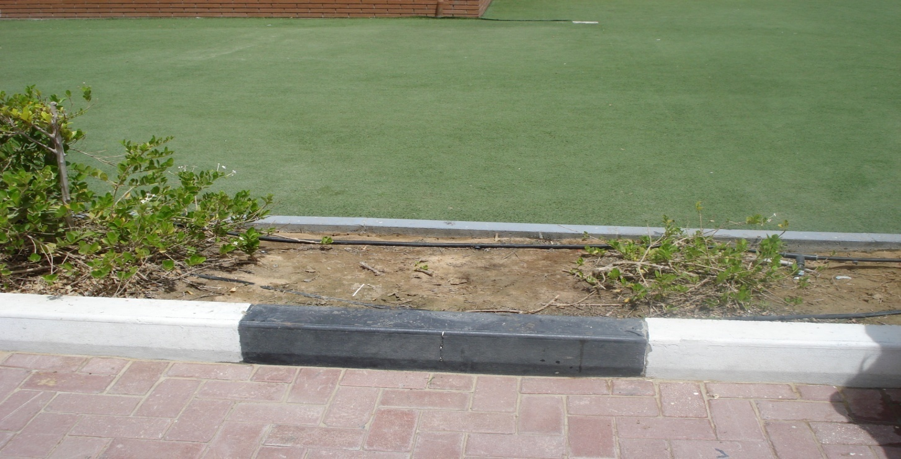
Dead plants
This shows there is poor landscapeing

Slide 8
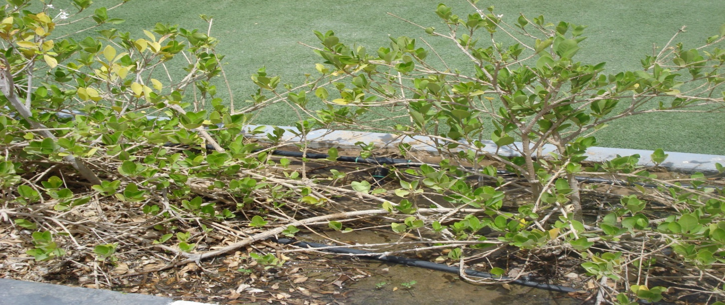
Flooding
There are broken braches but behind the braches there is flooding.

Slide 9
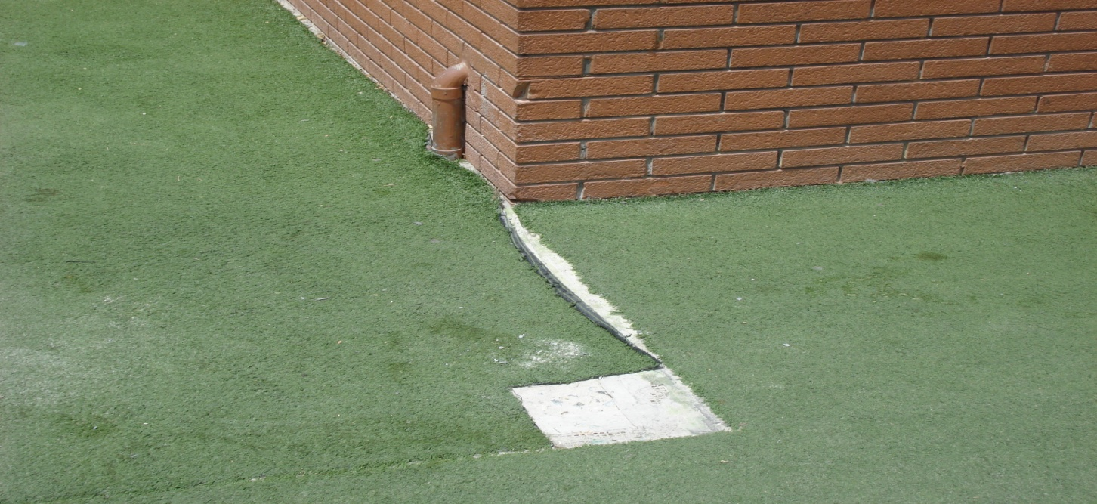
Ripped Astroturf
This shows that people aren’t taking care of the school enviroment

Slide 10
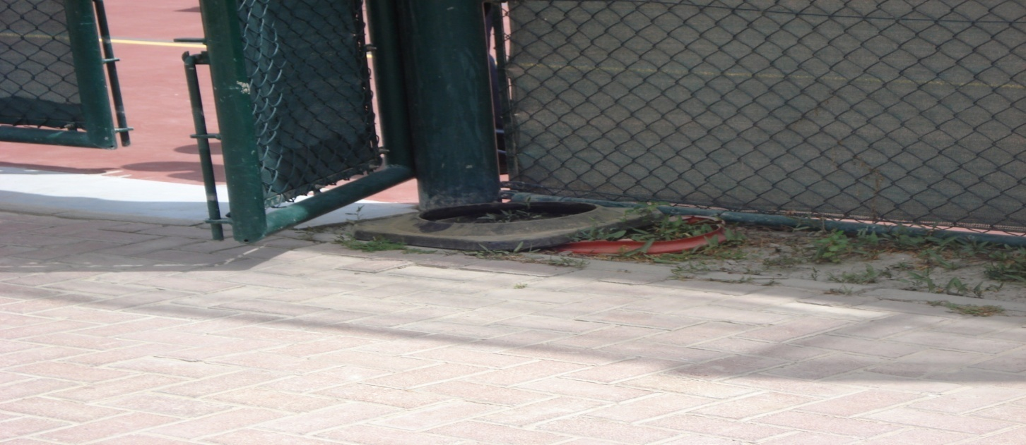
Litter
Next to the tennis court there are some broken cones which shows that no one wants to remove them.

Slide 11
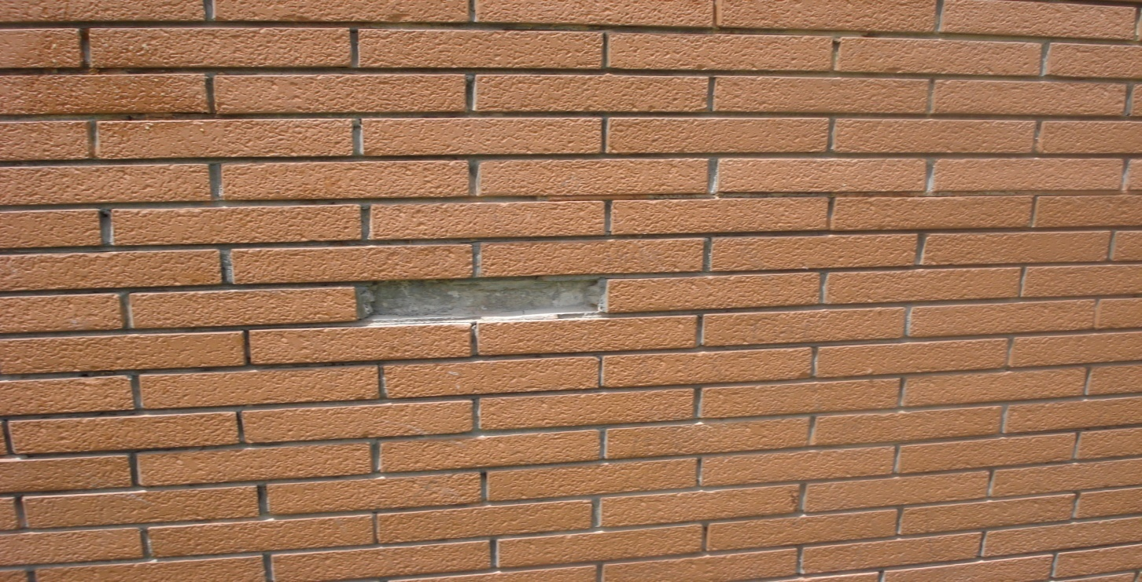
Missing brick
There is one missing brick in the wall which shows there is bad workmanship.

Slide 12
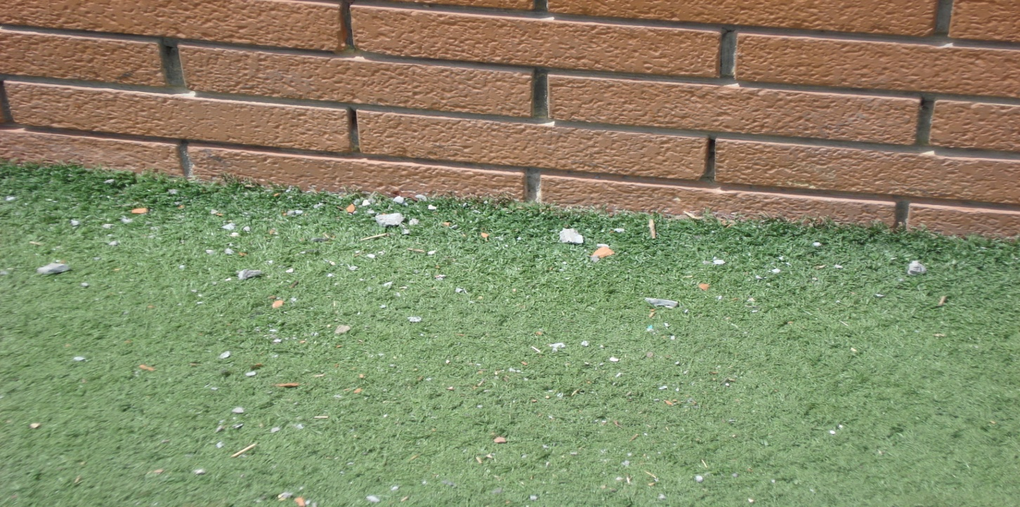
Crumbs and waste foods
On the green Astroturf there is small crumbs and waste foods, which shows people just throw there crumbs on the floor .

